Slide 1









IMDb CASE STUDY
A research project by Pritika Mahato.
This Photo by Unknown Author is licensed under CC BY-NC-ND
This Photo by Unknown Author is licensed under CC BY-NC-ND

Slide 2
CONTENT
Introduction
DATA ANALYSIS
TABLE ANALYSIS
DATABASE DETAILS
ENTITY-RELATIONSHIP (ER) DIAGRAM
LOGICAL SCHEMA

Slide 3
INTRODUCTION
In this project we will build a MySQL database using the Internet Movie Database (IMDb) dataset. The dataset consists of 7 compressed tab-separated-value (*.xml) files, which are explained and available for download from the link.
Link : https://drive.google.com/file/d/1K90f9A-YEglEkkivpjSovpXK-yJjISIp/view?usp=sharing
The purpose of this project is to do the following:
Learn about and use the database management system MySQL.
Learn the essentials of database design, e.g., Entity-Relationship diagrams, logical schema, and database normalisation.
Practice database querying by posing basic and more advanced queries using MySQL directly.

Slide 4
DATA ANALYSIS
The tangible steps we will take in this project are:
Understand the data in the IMDb dataset.
Design a relational database and store the IMDb data in it.
Model the database using an Entity-Relationship (ER) diagram.
Create MySQL database.
Load data into the database.
Add primary and foreign key constraints.
Create database indexes.
Ask questions of the IMDb data, so as to practice simple and more advanced SQL queries.
Throughout we will adhere to SQL style conventions. In particular, underscores will be used in attribute names rather than camel case, which is used in the IMDb data files.

Slide 5
TABLE ANALYSIS
The available IMDb data files are as follows:
1. name.basics.tsv.gz
Contains the following information for names:
• nconst (string) - alphanumeric unique identifier of the name/person. • primaryName (string)– name by which the person is most often credited. • birthYear – in YYYY format. • deathYear – in YYYY format if applicable, else “\N”. • primaryProfession (array of strings) – the top-3 professions of the person. • knownForTitles (array of tconsts) – titles the person is known for.
2. title.basics.tsv.gz
Contains the following information for titles:
• tconst (string) - alphanumeric unique identifier of the title. • titleType (string) – the type/format of the title (e.g. movie, short, tvseries, tvepisode, video, etc). • primaryTitle (string) – the more popular title / the title used by the filmmakers on promotional materials at the point of release. • originalTitle (string) - original title, in the original language. • isAdult (boolean) - 0: non-adult title; 1: adult title. • startYear (YYYY) – represents the release year of a title. In the case of TV Series, it is the series start year. • endYear (YYYY) – TV Series end year. “\N” for all other title types. • runtimeMinutes – primary runtime of the title, in minutes. • genres (string array) – includes up to three genres associated with the title.

Slide 6
3. title.akas.tsv.gz
Contains the following information for titles: • titleId (string) - a tconst which is an alphanumeric unique identifier of the title. • ordering (integer) – a number to uniquely identify rows for a given titleId. • title (string) – the localised title. • region (string) - the region for this version of the title. • language (string) - the language of the title.
• types (array) - Enumerated set of attributes for this alternative title. One or more of the following: “alternative”, “dvd”, “festival”, “tv”, “video”, “working”, “original”, “imdbDisplay”. New values may be added in the future without warning. Please note that types is said to be an array. In the data we have this appears to not be true. There appears to be only one string for each pair of titleId and ordering values. Also, there are many NULL (\N) values in this
field (~95%).
attributes (array) - Additional terms to describe this alternative title, not enumerated. Please note that attributes is said to be an array. In the data we have this appears to not be true. There appears to be only one string for each pair of titleId and ordering values. There are many NULL (\N) values in this field (~99%).
isOriginalTitle (boolean) – 0: not original title; 1: original title.
4. title.crew.tsv.gz
Contains the director and writer information for all the titles in IMDb. Fields include:
• tconst (string) - alphanumeric unique identifier of the title. • directors (array of nconsts) - director(s) of the given title. • writers (array of nconsts) – writer(s) of the given title.

Slide 7
5. title.episode.tsv.gz
Contains the tv episode information. Fields include:
• tconst (string) - alphanumeric identifier of episode. • parentTconst (string) - alphanumeric identifier of the parent TV Series. • seasonNumber (integer) – season number the episode belongs to. • episodeNumber (integer) – episode number of the tconst in the TV series.
6. title.principals.tsv.gz
Contains the principal cast/crew for titles
• tconst (string) - alphanumeric unique identifier of the title. • ordering (integer) – a number to uniquely identify rows for a given titleId. • nconst (string) - alphanumeric unique identifier of the name/person. • category (string) - the category of job that person was in. • job (string) - the specific job title if applicable, else “\N”. • characters (string) - the name of the character played if applicable, else “\N” (It is really “[role1,role2,. . . .]” or “\N”).
7. title.ratings.tsv.gz
Contains the IMDb rating and votes information for titles
• tconst (string) - alphanumeric unique identifier of the title. • averageRating – weighted average of all the individual user ratings. • numVotes - number of votes the title has received.

Slide 8
DATASET DETAILS
Each dataset is contained in a gzipped tab-separated-values (.xml) formatted file in the UTF-8 character set. The first line in each file contains headers that describe what is in each column. A "\N" is used to denote that a particular field is missing or has a NULL value for that title or name. It should be noted that the data available for download from the IMDb website is not the full dataset, but it will suffice for our purposes.

Slide 9
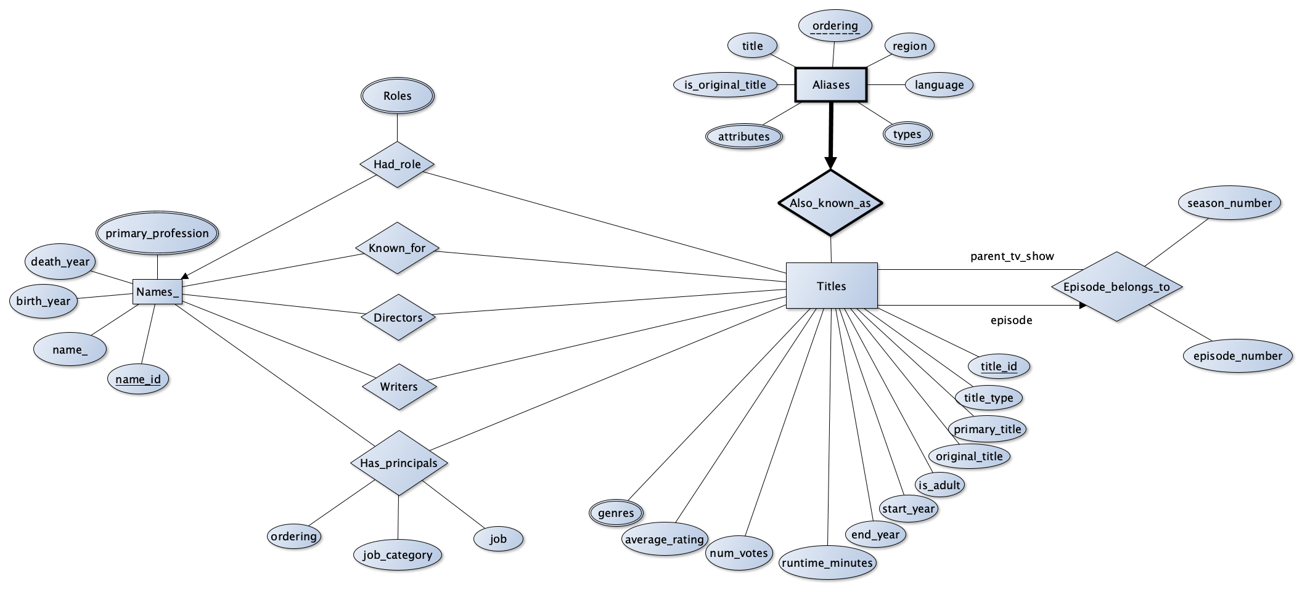
ENTITY-RELATIONSHIP (ER) DIAGRAM
The IMDb data as provided is not normalised. We first design an entity-relationship diagram for our IMDb relational database. This is shown below.

Slide 10
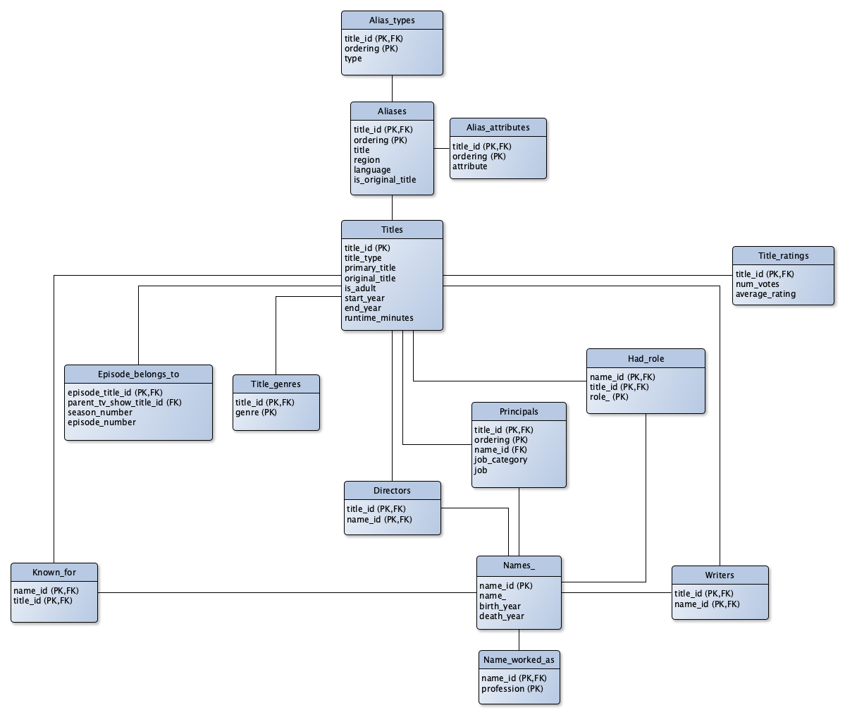
LOGICAL SCHEMA
We then normalise our ER diagram and obtain the logical schema illustrated below. Note the following:
New tables were created for multi-valued attributes, such as Title_genres.
We pulled the rating information attributes from the Titles entity, because many titles didn't have a rating. If we were to store them in the Titles table, then we would have stored many NULL values. Instead we decided to separate this information, by putting it into the table Title_ratings.

Slide 11
SQL QUERIES USING DATA VISUALISATION
This notebook is by no means a thorough exploration of the IMDb dataset. Its purpose is to practice querying a database. In particular, we consider the following questions:
• What are the average ratings for the TV show ‘The X-files’? • What genres are there? • How many movies are there in each genre? • How many movies are made in each genre each year?
• How do the average ages of leading actors and actresses compare in each genre?
• What is a typical runtime for movies in each genre?

Slide 12
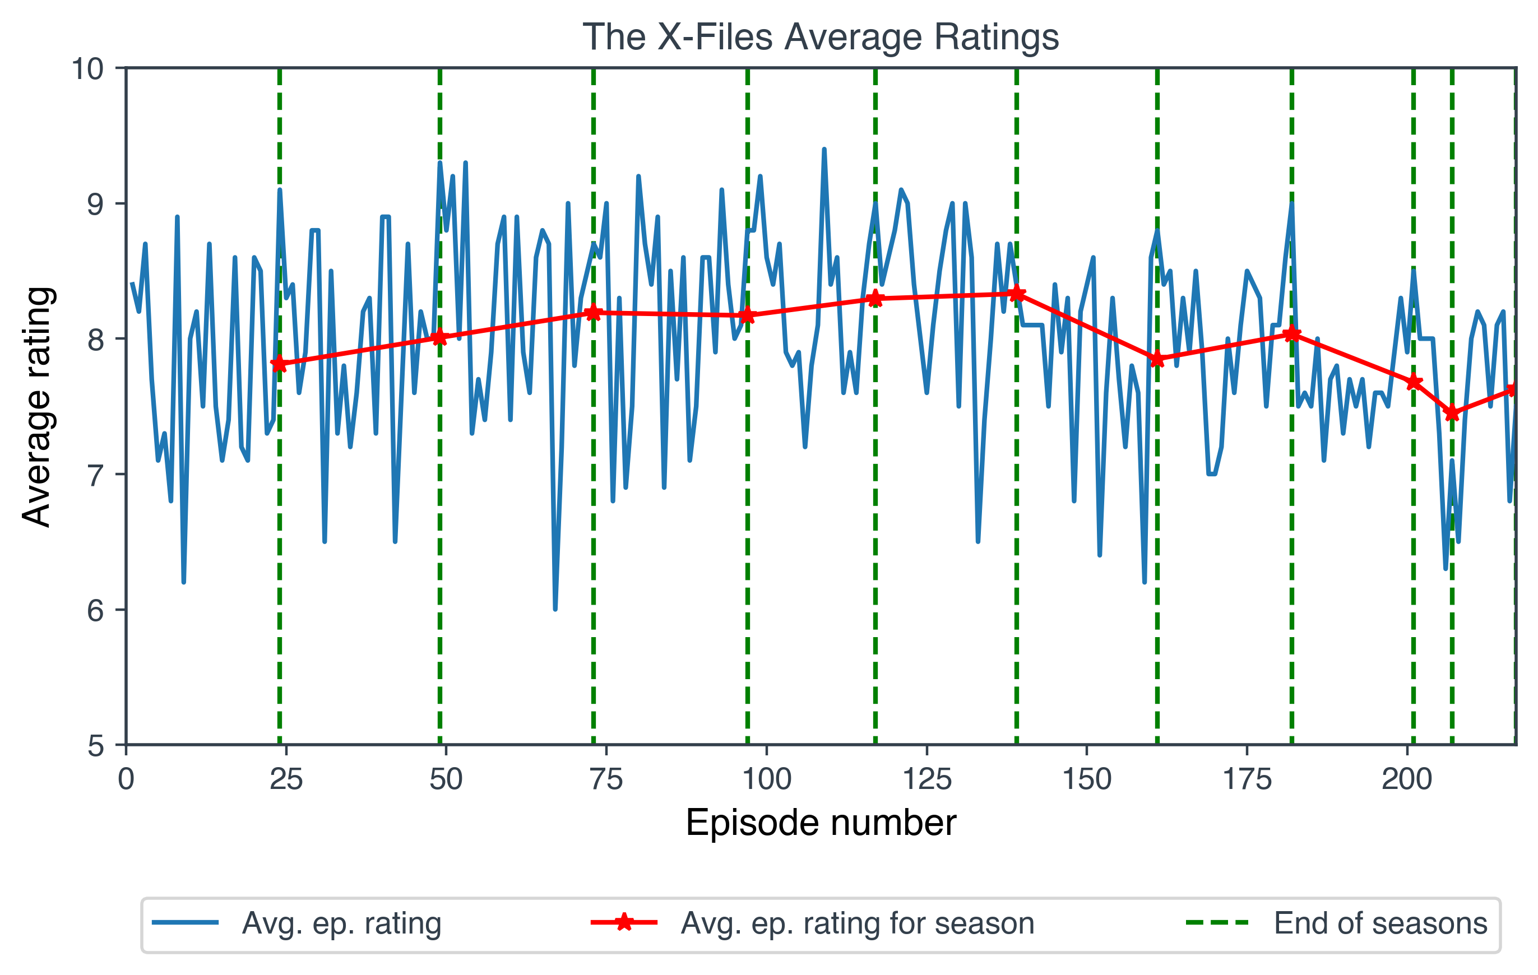
This section is also an ongoing piece of work, which will be added to in the future.
As a sample of the kind of querying and visualisation performed in this notebook we show a few of the created figures:

Slide 13
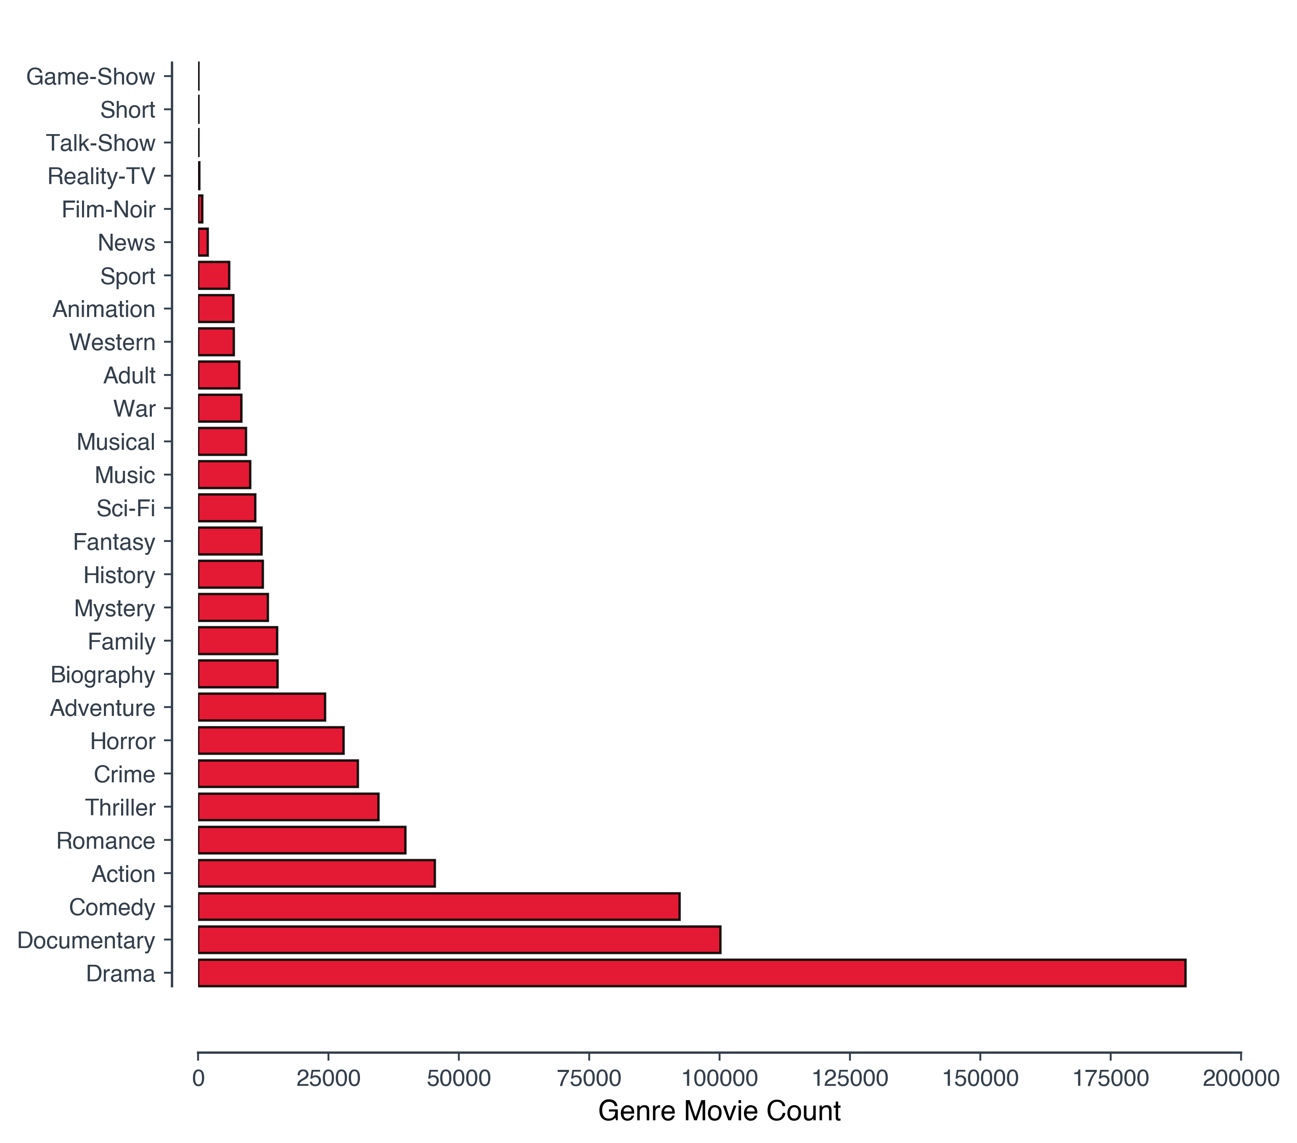

Slide 14
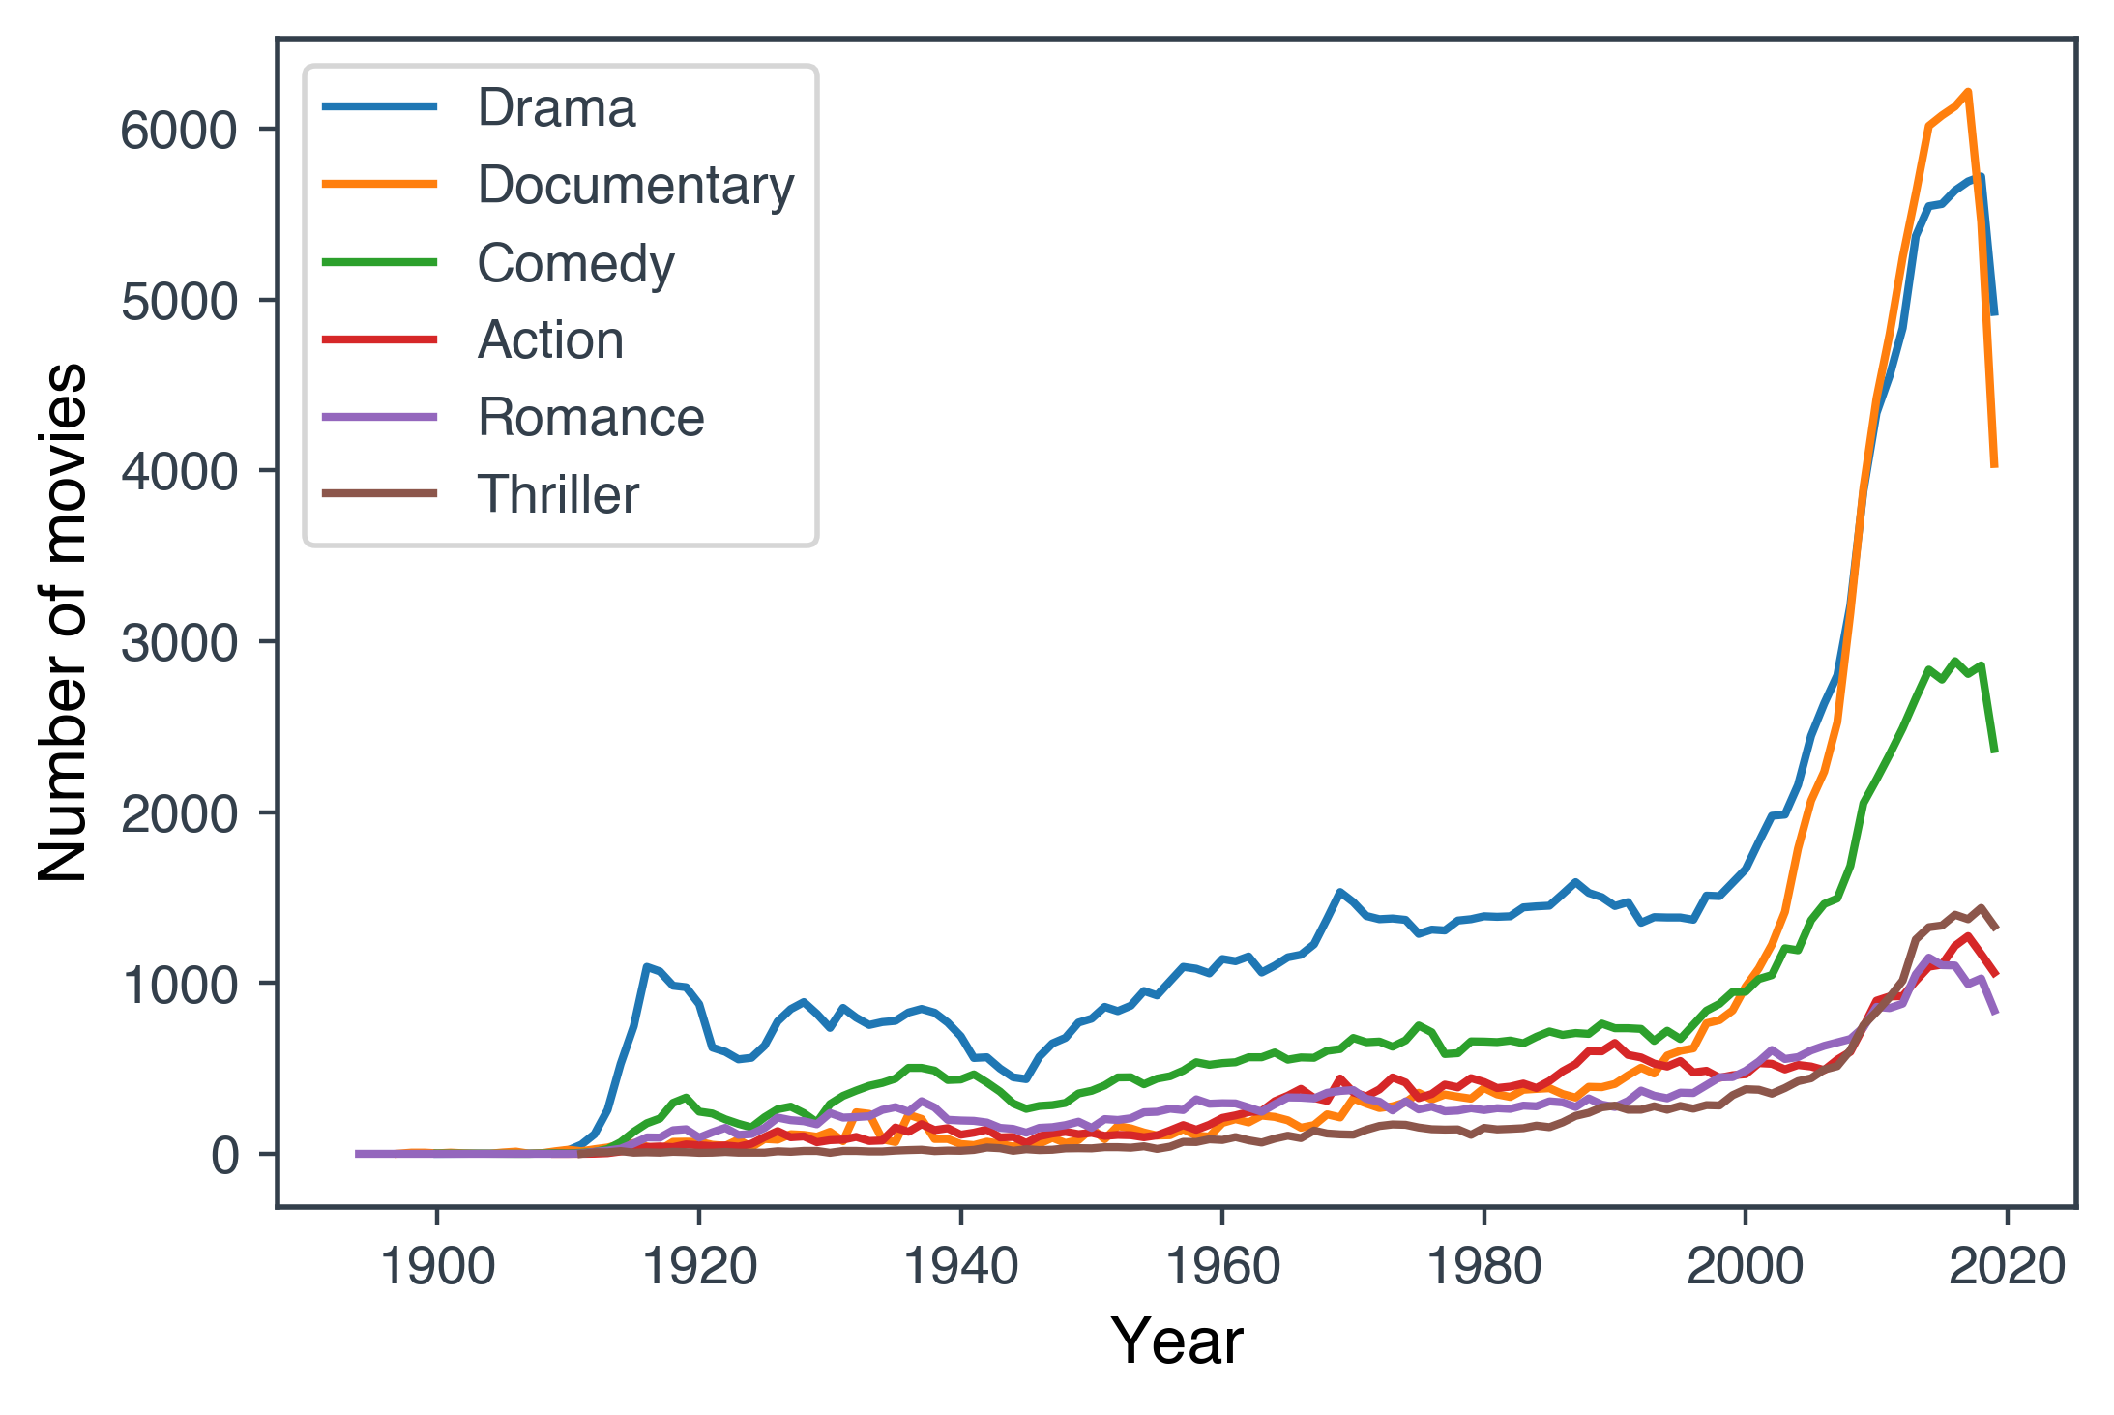

Slide 15
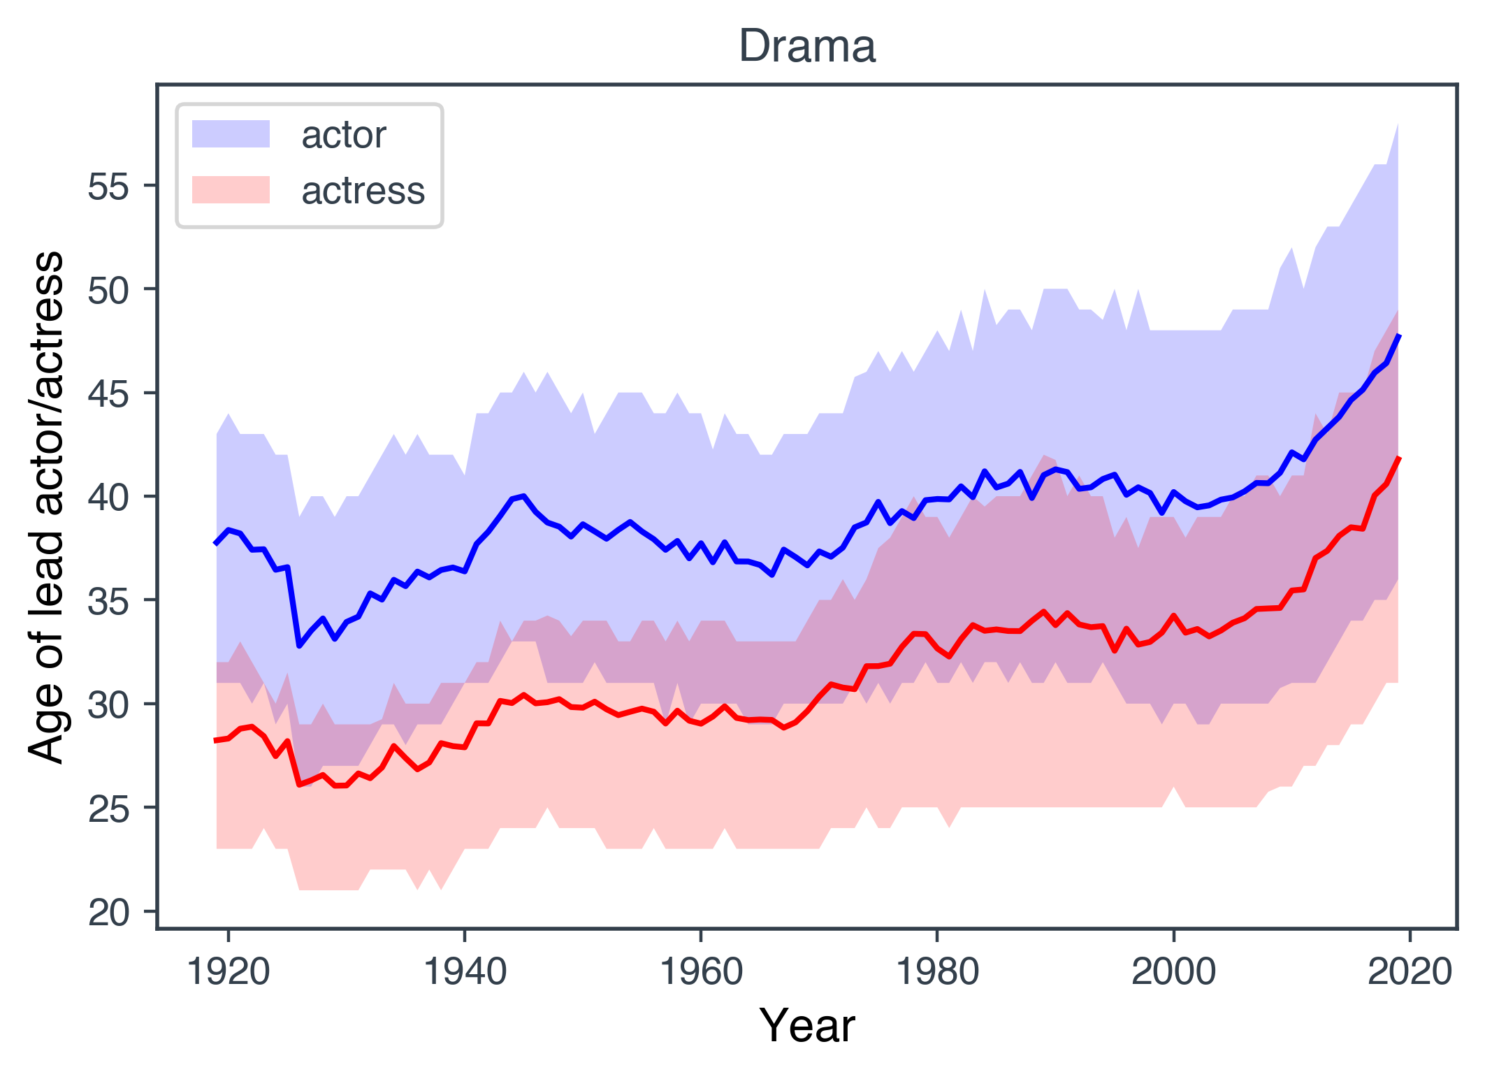

Slide 16
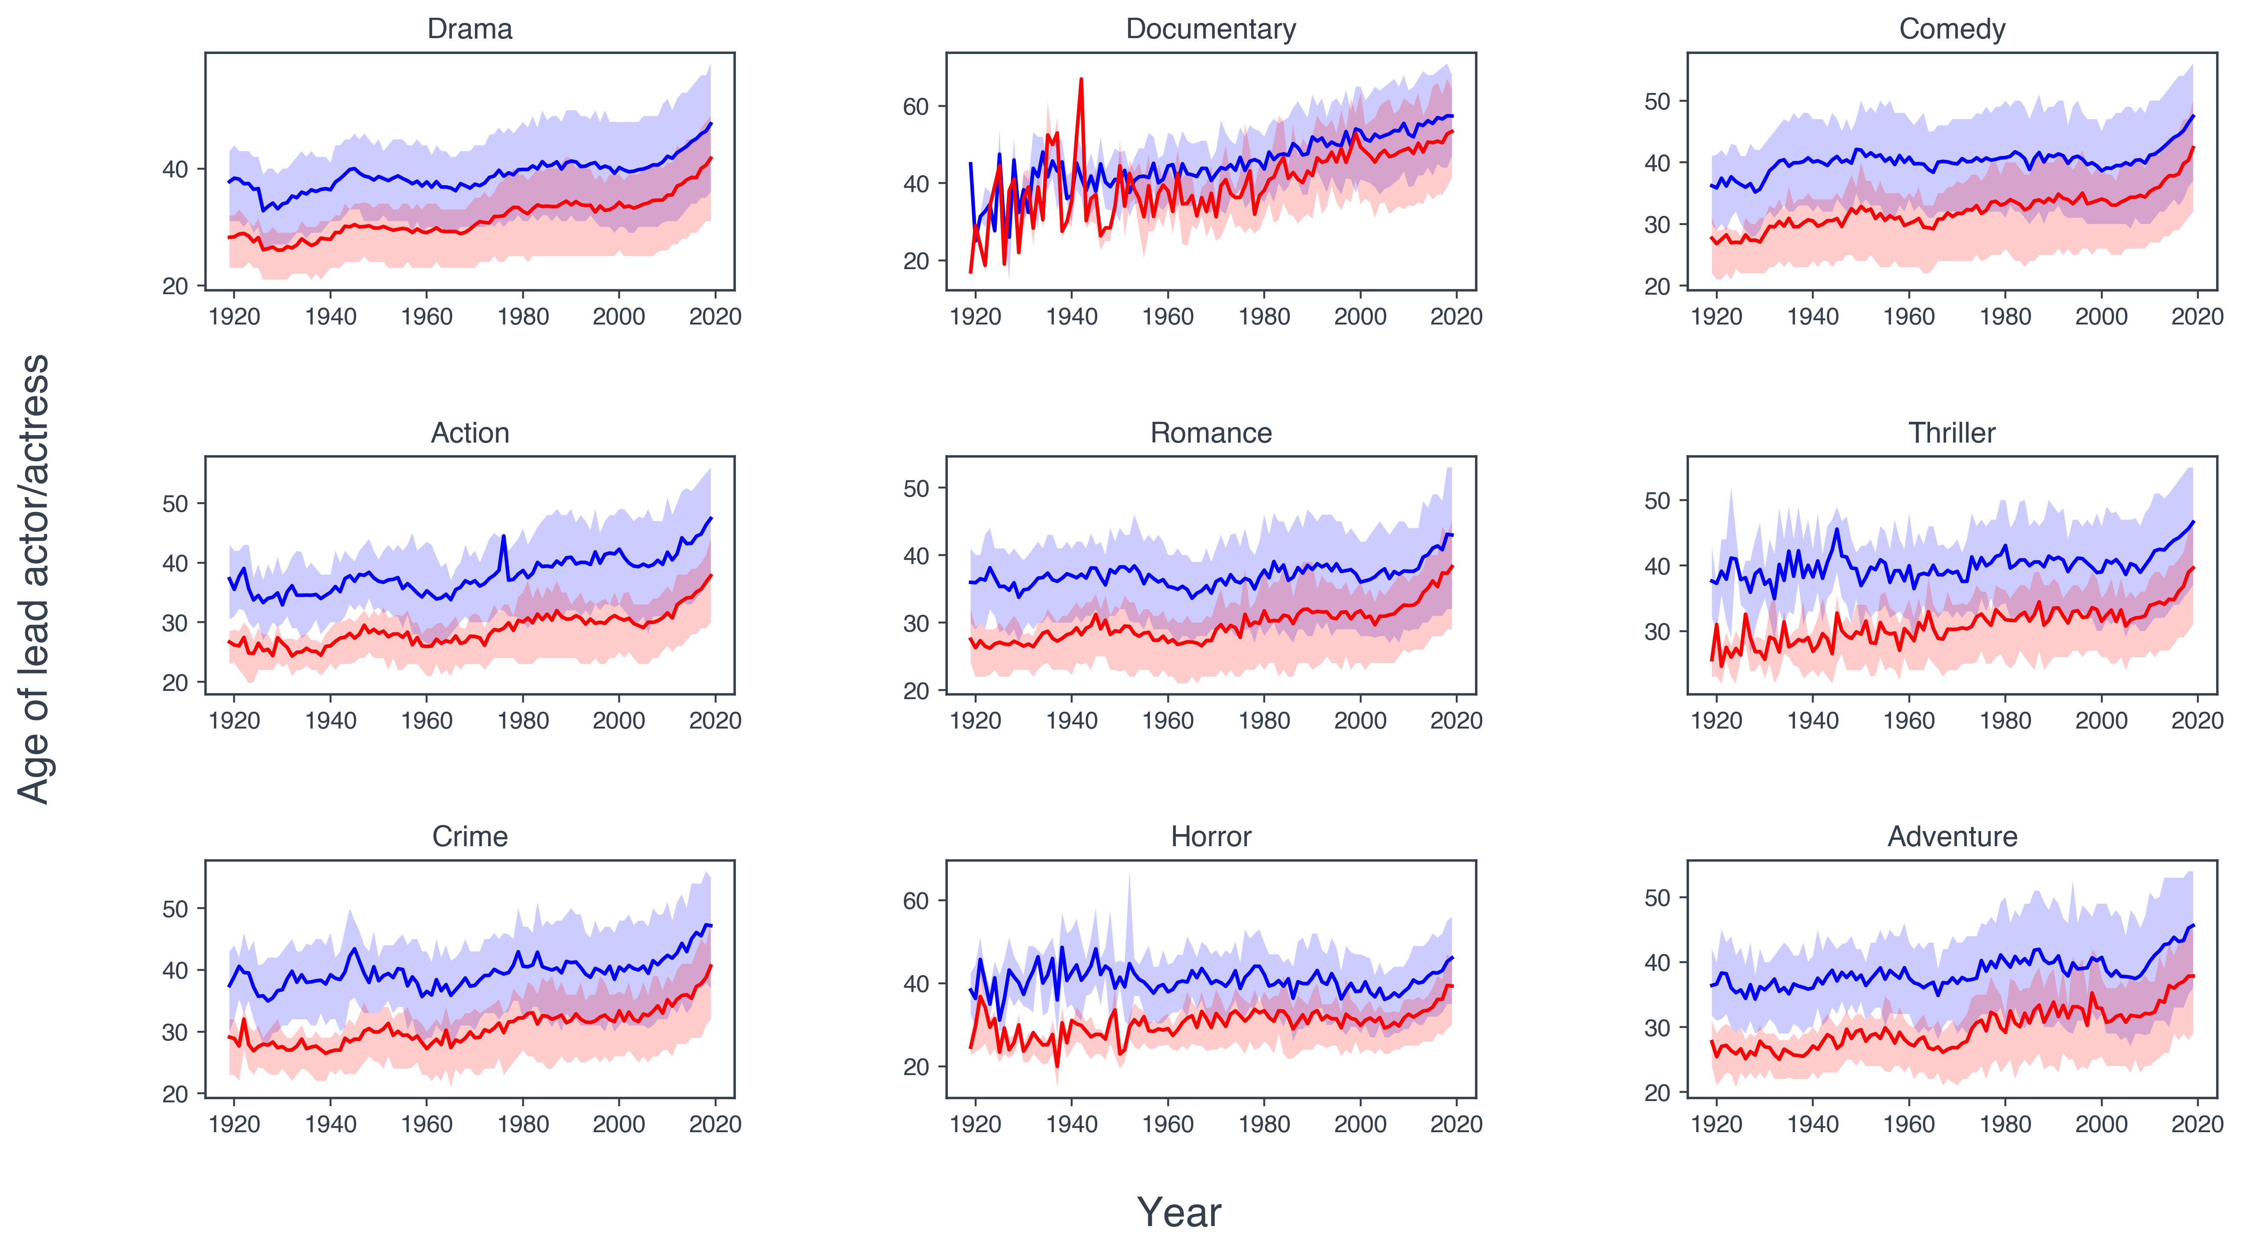

Slide 17
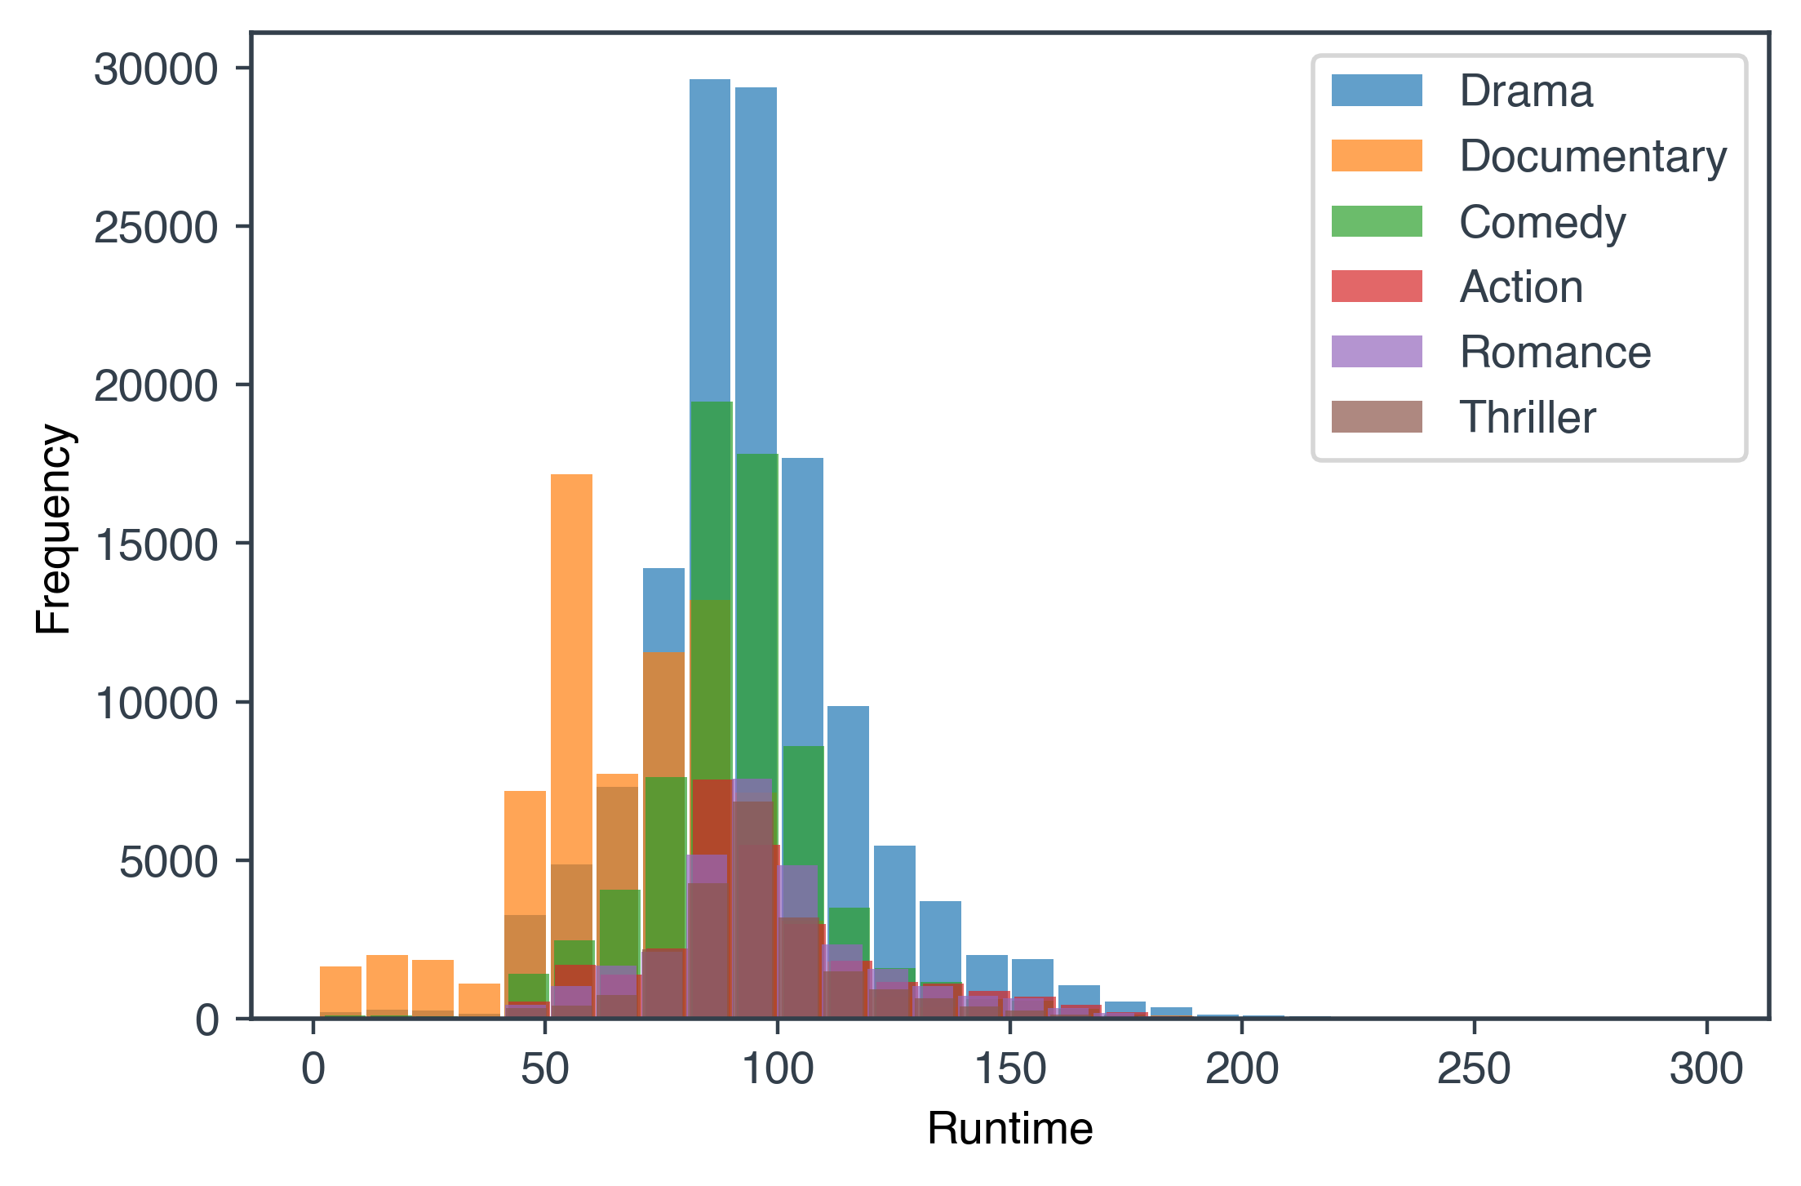

Slide 18
THANK YOU

